Slide 1

trespassing detection on Railway Tracks Through video surveillance
Dr. D.Y. Patil Institute Of Engineering And Technology Ambi, Pune
Team:
Yogesh Rajgure, 81
Harsh Ingle, 57
Karthik Arumugam, 25
GROUP 8
GUIDED BY:
PROF. MANGESH MANAKE

Slide 2
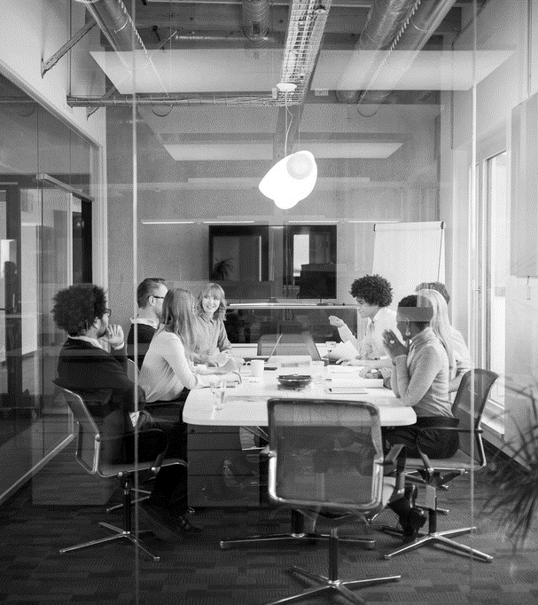
Agenda
Project title & domain
Introduction
Literature survey
Review papers
Existing system
Problem statement
Project objective
Scope of project
Proposed work
Algorithm & methodology
Architecture
Use case diagram
Advantages
Disadvantages
Application
Project work completion plan
Conclusion
Future Scope
References

Slide 3
INTRODUCTION
Railways are the most widely used mode of transportation in India. Also railway stations are the most crowded places across country, in such scenario, cases of civilians not following rules at the platform has become a common phenomenon. According to a report, from 2006 to 2015, 2717 deaths and 9595 injuries have been reported to be a direct result of trespassing activity in the country.
Such attitude leads to the unnecessary accidents and deaths of common people. One most common thing we can find now days in these places in the CCTV cameras. We can take the help of modern technology (AI integrated with CCTV cameras) and employ it to saving lives.
Our project idea has a potential to save these precious lives.

Slide 4
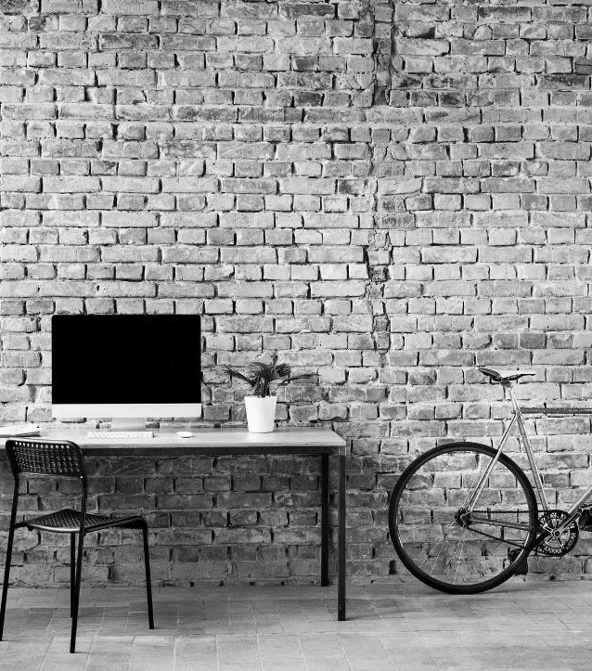
Literature Review
Lets deep dive into it
[Shah] employed color-based background subtraction to detect moving objects. They use color, motion and size-based features to track those objects. Tracked objects are classified into people, a group of people or a vehicle.
[Salmane] proposed a multistage system that uses frame-based background subtraction for moving object detection. However, moving objects are not discriminated into train, vehicle or persons as would be required for trespassing detection. Further, as noticed by Zhang even though the system is expected to run in real time, no information regarding the speed of the algorithm is reported.

Slide 5
PAPERS REVIEW
YEAR | AUTHOR | PURPOSE | TECHNIQUES USED | LIMITATIONS | ADVANTAGES (A)/ DISADVANTAGES (D)
2020 | Hamad Alawad , Sakdirat Kaewunruen , Min An | A deep learning approach towards railway safety risk assessment | Deep learning, CNN | The data (both images and videos) collected from the web require intensive cleaning. The variety of sources imposes many constraints, images with poor quality and obstructed vision (to the point that the targets cannot be seen) must be removed. | A - Railway stations feature dynamic and complex conditions. D - A Convolutional neural network is significantly slower due to an operation such as maxpool.
2019 | Muzammil Bashir, Elke A. Rundensteiner, Ramoza Ahsan | A deep learning approach to trespassing detection using video surveillance data | Deep learning, CNN, ARTS, CV, Video Surveillance | These deep learning-based methods, while effective, are known to be computationally expensive and time consuming, especially when applied to a large volume of surveillance data. | A - The resulting dual-stage ARTS architecture represents a flexible solution capable of trading-off accuracy with computational time. D - User must provide good image. System will not work properly with damaged image.

Slide 6
YEAR | AUTHOR | PURPOSE | TECHNIQUES USED | LIMITATIONS | ADVANTAGES (A)/ DISADVANTAGES (D)
2021 | Huy Hoang Nguyen, Thi Nhung Ta, Ngoc Cuong Nguyen, Van Truong Bui, Hung Manh Pham, Duc Minh Nguyen | YOLO Based Real-Time Human Detection for Smart Video Surveillance at the Edge | YOLO, SSD, SPP, L-CNN | The high detection rates, deep learning methods with edge devices in order to detect human objects. However, with high computation costs, it is challenging to apply these methods on resource limited edge. | A - High Detection Rate in Deep Learning D - When a system needs to handle vast numbers of cameras at the same time, the system needs a high processing speed and configuration must be powerful.
2020 | Mohit Pandiya, Sayonee Dassani, Dr. Mangalraj P | Analysis of Deep Learning Architectures for Object Detection - A Critical Review | Deep Learning, Object Detection, Optimal, Comparison, CNN | The various CV techniques suffer from major challenges such as ambiguity, accuracy, speed, etc. CV algorithms face problems when classifying between two similar looking classes causing ambiguity. | A - Through analysis we look into every aspects with proper statistical methods D - Vanishing gradient problem may occurs when training deep CNNs.
2020 | Guangli Wu*, Zhenzhou Guo, Leiting Li, Chengxiang Wang | Video Abnormal Event Detection Based on CNN and LSTM | CNN, LSTM, TCNN-LSTM | The main difficulty of this task lies in that there is only one class called “normal event” in training video sequences. | A - High detection precision, Low misdetection rate D - The noise of video will be increase due to the influence of light and rain, which will affect the detection of abnormal events in video.

Slide 7
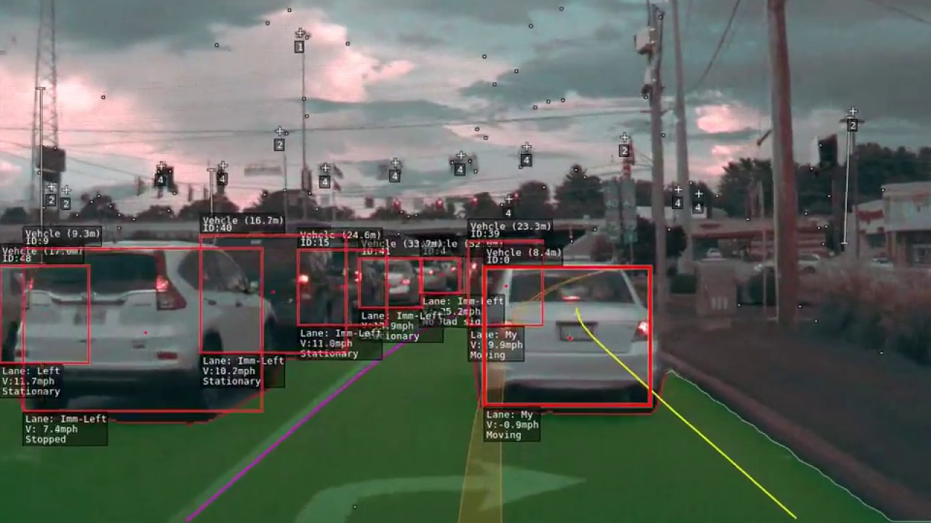
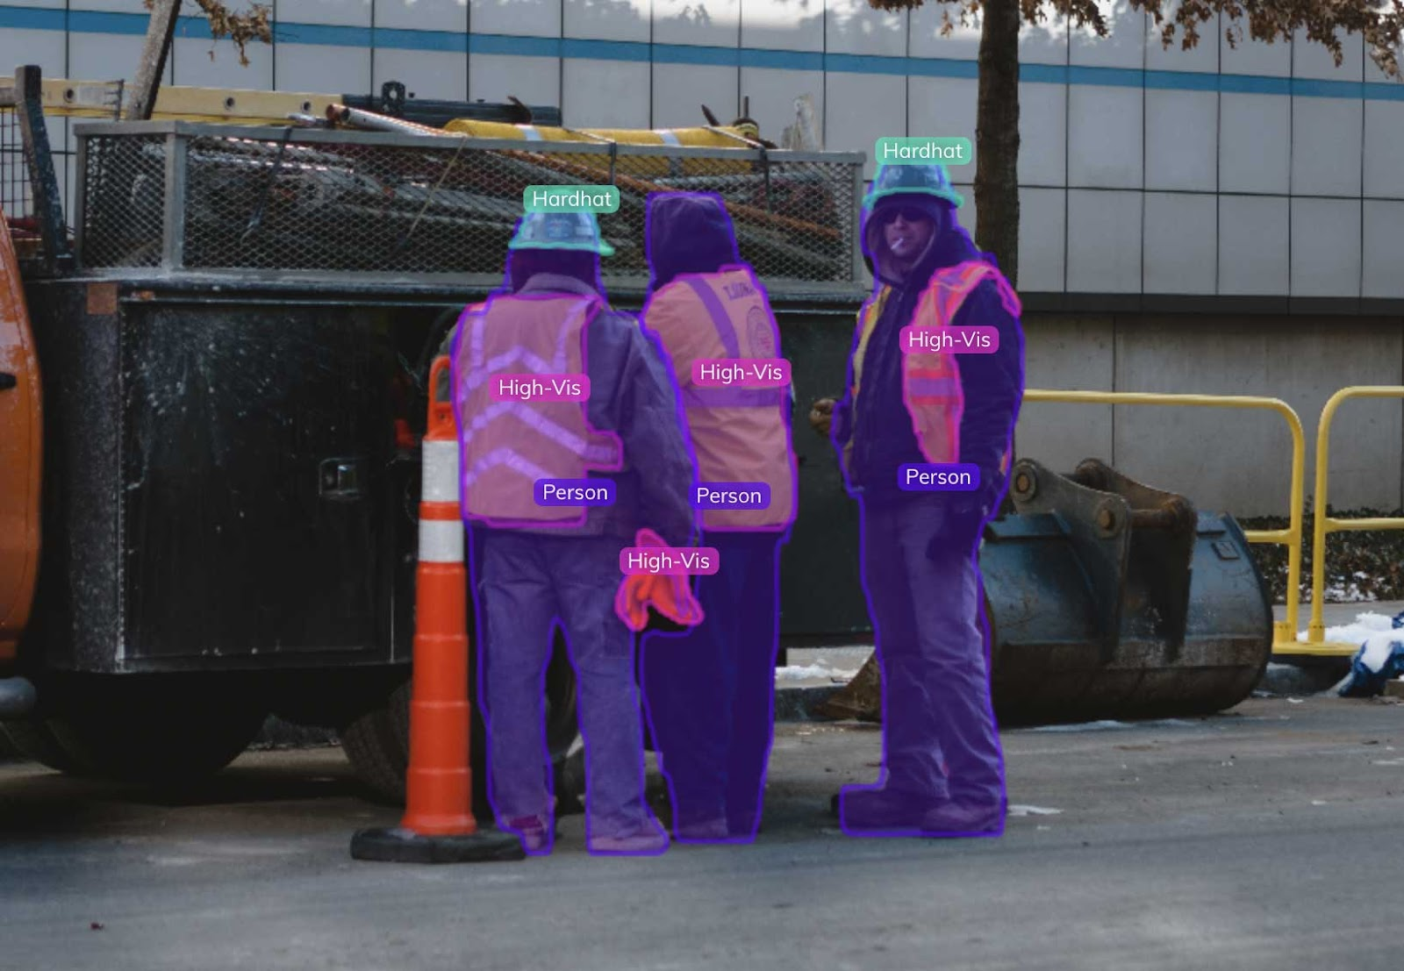
Existing System
Tesla has already employed their self-driving cars, entirely driven by Machine Learning and Computer Vision at its core.
Of which, one of the main feature is to detect any object (using sensors/cameras) in its driving range to take the necessary action.
Banking Vault are constantly under surveillance of camera’s, have recently employed deep learning systems too. The main function of these systems is to detect the presence of objects when they pass the certain boundary. Thereby, providing an upper edge to the security systems over human errors.
Almost every organization uses the deep learning systems to differ between staff(wearing same uniform, etc.) and the commoners, using certain features.

Slide 8
PrOBLEM Statement
Trying to analyse different motion surveillance videos on railway tracks and identifying intrusion of objects or people in enclosed/restricted area.
Sending distress signals to clear out the danger and further to concerned authorities to take necessary actions.

Slide 9

Objective
The main objective of this project is to employ the AI to human Safety, with the help of Computer Vision and Deep Learning algorithms.
Using the Human Detection, Staff Detection, Boundary Detection and combining data to alert the trespassing scenario.

Slide 10
Scope of the project
This project starts with the focus on human detection in the live frame that is being feed to it through cameras.
Upon detection of human, algorithm detects if that human is worker or civilian(with the help of uniform).
After detection of civilian, it detects if that civilian is outside the boundary or inside it.
If that civilian is inside the boundary( very close to the track), an alarm can be raised on nearby speaker, informing about the trespassing, to the other people there, and one alarm to the police section.
If any of the two(police/people) intervenes in time, a big accident can be avoided.

Slide 11

Proposed work
The project achieves its goal through 3 main parts, namely
Object Recognition
Boundary Detection
Alert System
These 3 parts combine to form the entire project architecture.

Slide 12
Algorithm and methodology
Step by step overview:
This project starts with the focus on human detection in the live frame that is being feed to it through cameras.
Upon detection of human, algorithm detects if that human is worker or civilian(with the help of uniform).
After detection of civilian, it detects if that civilian is outside the boundary or inside it.
If that civilian is inside the boundary( very close to the track), an alarm can be raised on nearby speaker, informing about the trespassing, to the other people there, and one alarm to the police section.
If any of the two(police/people) intervenes in time, a big accident can be avoided.

Slide 13
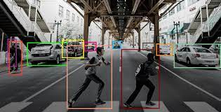
Object Recognition
Object recognition refers to a collection of related tasks for identifying objects in digital photographs.
Computer Vision
Image Classification
Object localization
Object detection
Ability to perceive an object's physical properties (such as shape, color and texture) and apply semantic attributes to the object
Recognizing, identifying, and locating objects within a picture with a given degree of confidence.

Slide 14
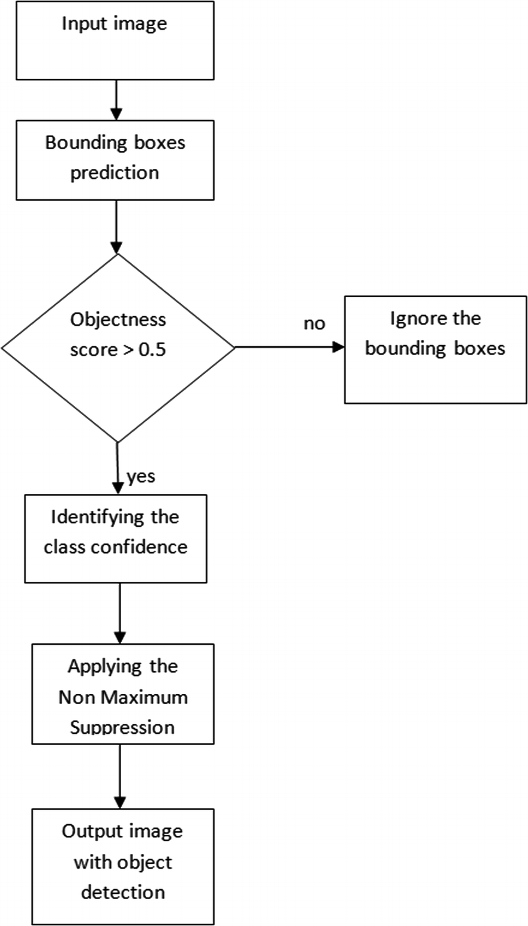
Yolo -Objection Detection & Trespassing in Railways
YOLO algorithm employs convolutional neural networks (CNN) to detect objects in real-time.
The algorithm requires only a single forward propagation through a neural network to detect objects.
The prediction in the entire image is done in a single algorithm run. The CNN is used to predict various class probabilities and bounding boxes simultaneously.

Slide 15
YOLO algorithm
Yolo Algorithm
1.Residual Blocks
3..Intersection Over Union (IOU)
2. Bounding Box Regression
YOLO algorithm works using the following three techniques:
Residual blocks
Bounding box regression
Intersection Over Union (IOU)

Slide 16
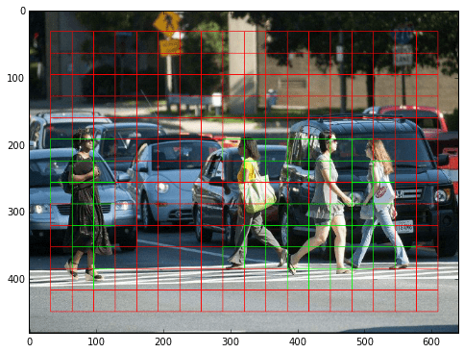
YOLO algorithm
Residual Blocks:-
1.First, the image is divided into various grids. Each grid has a dimension of S x S. The following image shows how an input image is divided into grids.
2. In the image, there are many grid cells of equal dimension. Every grid cell will detect objects that appear within them. For example, if an object center appears within a certain grid cell, then this cell will be responsible for detecting it.

Slide 17
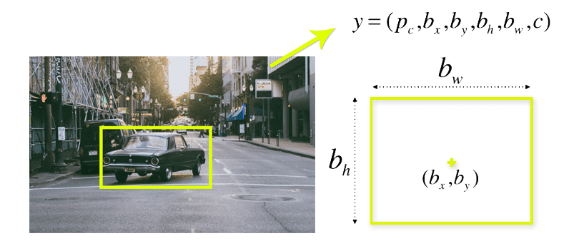
YOLO algorithm
Bounding box regression
A bounding box is an outline that highlights an object in an image.
Every bounding box in the image consists of the following attributes:
Width (bw)
Height (bh)
Class (for example, person, car, traffic light, etc.)- This is represented by the letter c.
Bounding box center (bx,by)
The image shows an example of a bounding box. The bounding box has been represented by a yellow outline.
YOLO uses a single bounding box regression to predict the height, width, center, and class of objects. In the image, represents the probability of an object appearing in the bounding box.

Slide 18
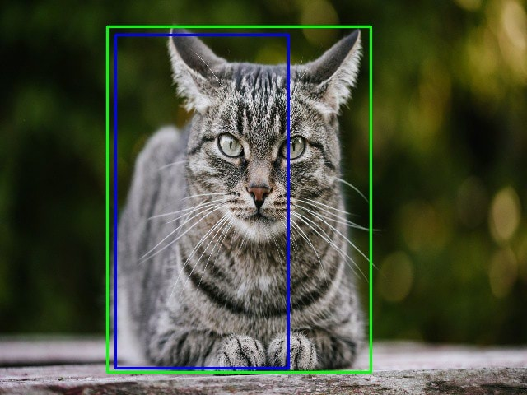
YOLO algorithm
Intersection over union (IOU):
1. Intersection over union (IOU) is a phenomenon in object detection that describes how boxes overlap. YOLO uses IOU to provide an output box that surrounds the objects perfectly.
2. Each grid cell is responsible for predicting the bounding boxes and their confidence scores. The IOU is equal to 1 if the predicted bounding box is the same as the real box. This mechanism eliminates bounding boxes that are not equal to the real box.
3. The following image provides a simple example of how IOU works.
4. In the image above, there are two bounding boxes, one in green and the other one in blue. The blue box is the predicted box while the green box is the real box. YOLO ensures that the two bounding boxes are equal.

Slide 19
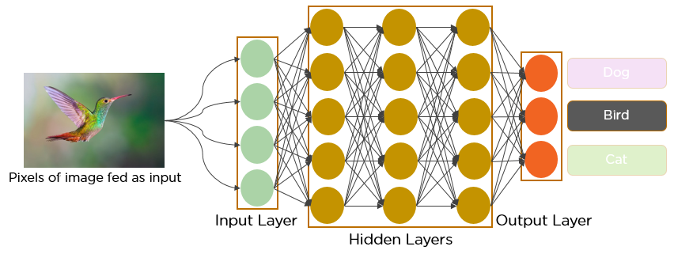
CNN – Convolutional Neural Networks
A Convolutional Neural Network (ConvNet/CNN) is a Deep Learning algorithm which can take in an input image, assign importance (learnable weights and biases) to various aspects/objects in the image and be able to differentiate one from the other.
The pre-processing required in a ConvNet is much lower as compared to other classification algorithms. While in primitive methods filters are hand-engineered, with enough training, ConvNets have the ability to learn these filters/characteristics.
The architecture of a ConvNet is analogous to that of the connectivity pattern of Neurons in the Human Brain and was inspired by the organization of the Visual Cortex. Individual neurons respond to stimuli only in a restricted region of the visual field known as the Receptive Field. A collection of such fields overlap to cover the entire visual area.

Slide 20
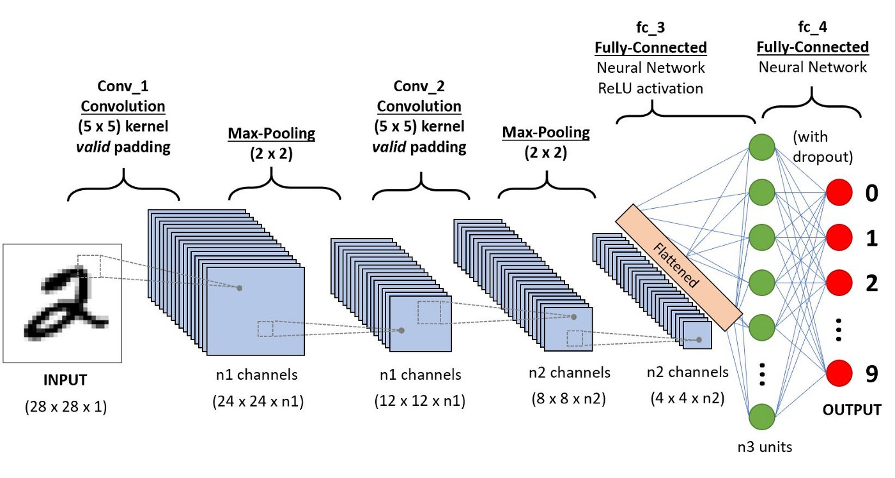
CNN - Architecture

Slide 21
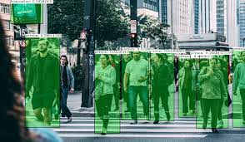
Open-CV: Realtime Object Recognition
The object detection works on the Viola-Jones algorithm, which was proposed by Paul Viola and Michael Jones. The aforementioned algorithm is based on machine learning.
The first step involves training a cascade function with a large amount of negative and positive labeled images.
Once the classifier is trained, identifying features, namely “HAAR Features,” are extracted from these training images. HAAR features are essentially rectangular features with regions of bright and dark pixels.

Slide 22
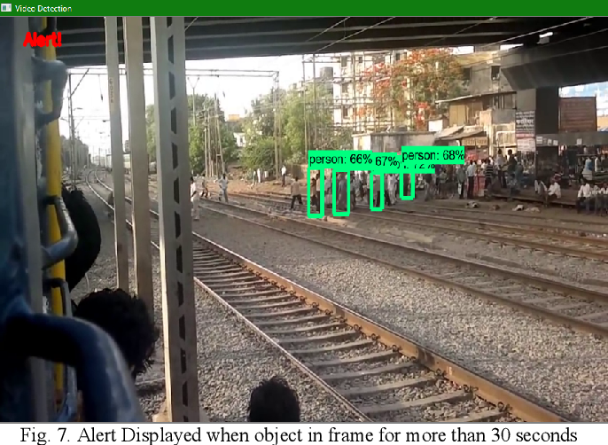
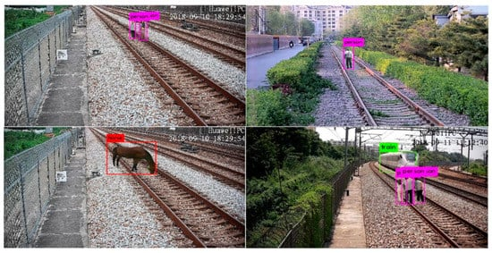
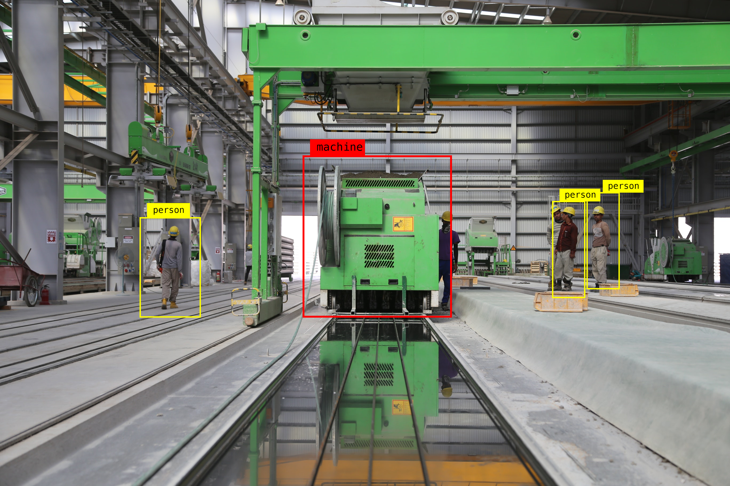
Objection Detection & Trespassing in Railways

Slide 23
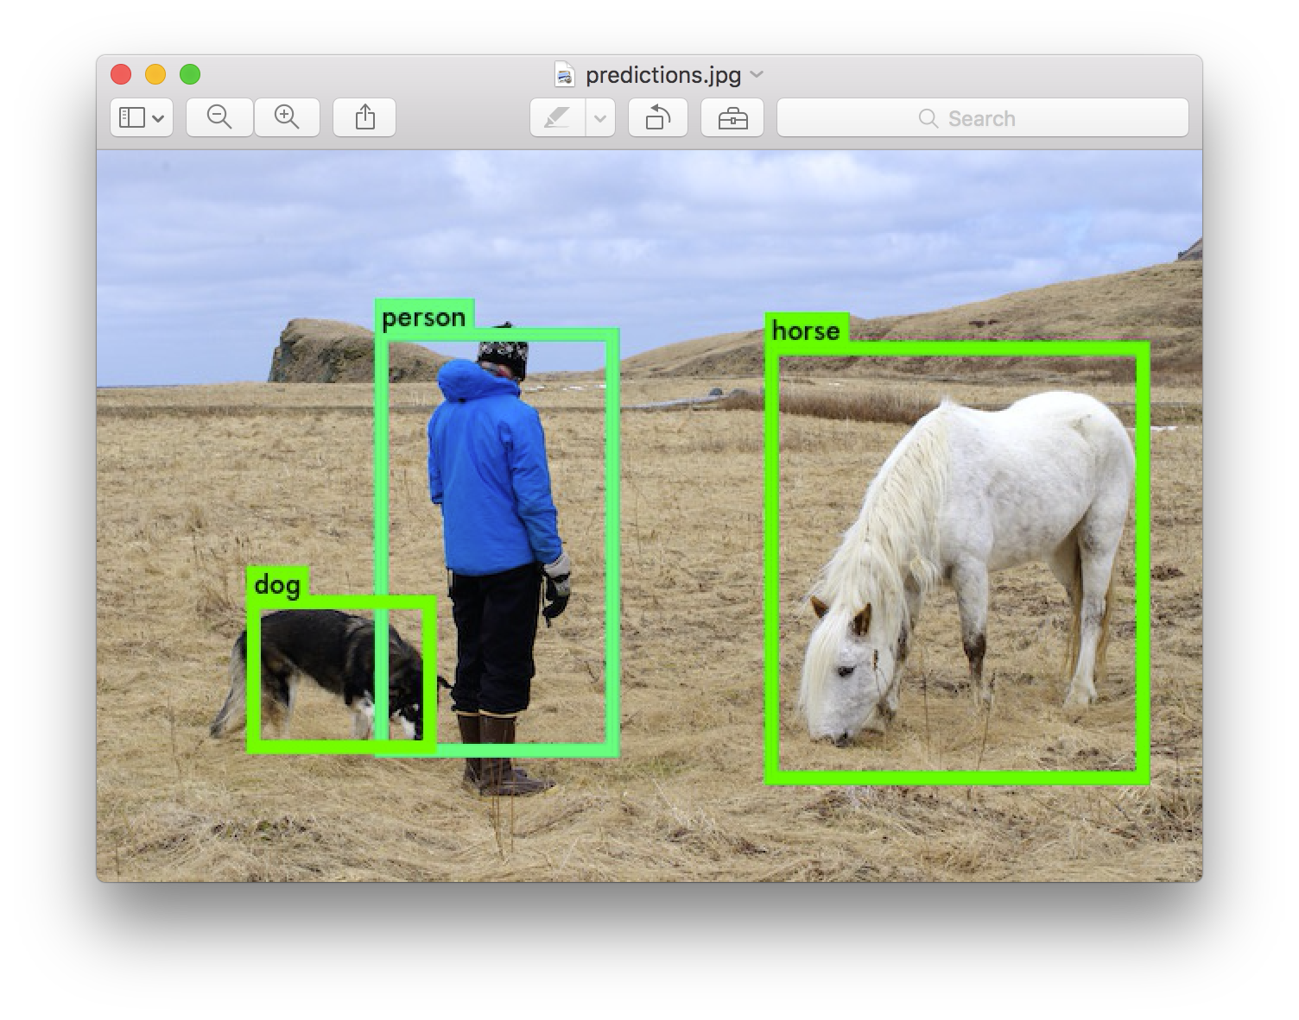
Open-CV: Realtime Object Recognition
Each feature's value is calculated as a difference between the sum of pixel intensity under the bright region and the pixel intensity under the dark region.
All the possible sizes and location of the image is used to calculate these features. An image might contain many irrelevant features and few relevant features which can be used to identify the object.
The classifier is trained with the pre-labeled dataset to extract the useful features to get the minimum errors by applying appropriate weights to each feature. An individual feature is called a weak feature.
The final classifier is the weighted sum of the weak features. A large region of the image contains the background; only a certain region contains the object to be detected. To increase the detection speed, cascading of classifiers is implemented. In this process, if a region of an image gives even a single negative feature, that region is disregarded for further processing, and the algorithm moves on to the next region.
The only region which contains all the identifying features is outlined as the required object in the image.

Slide 24

GUI Implementation Of project

Slide 25
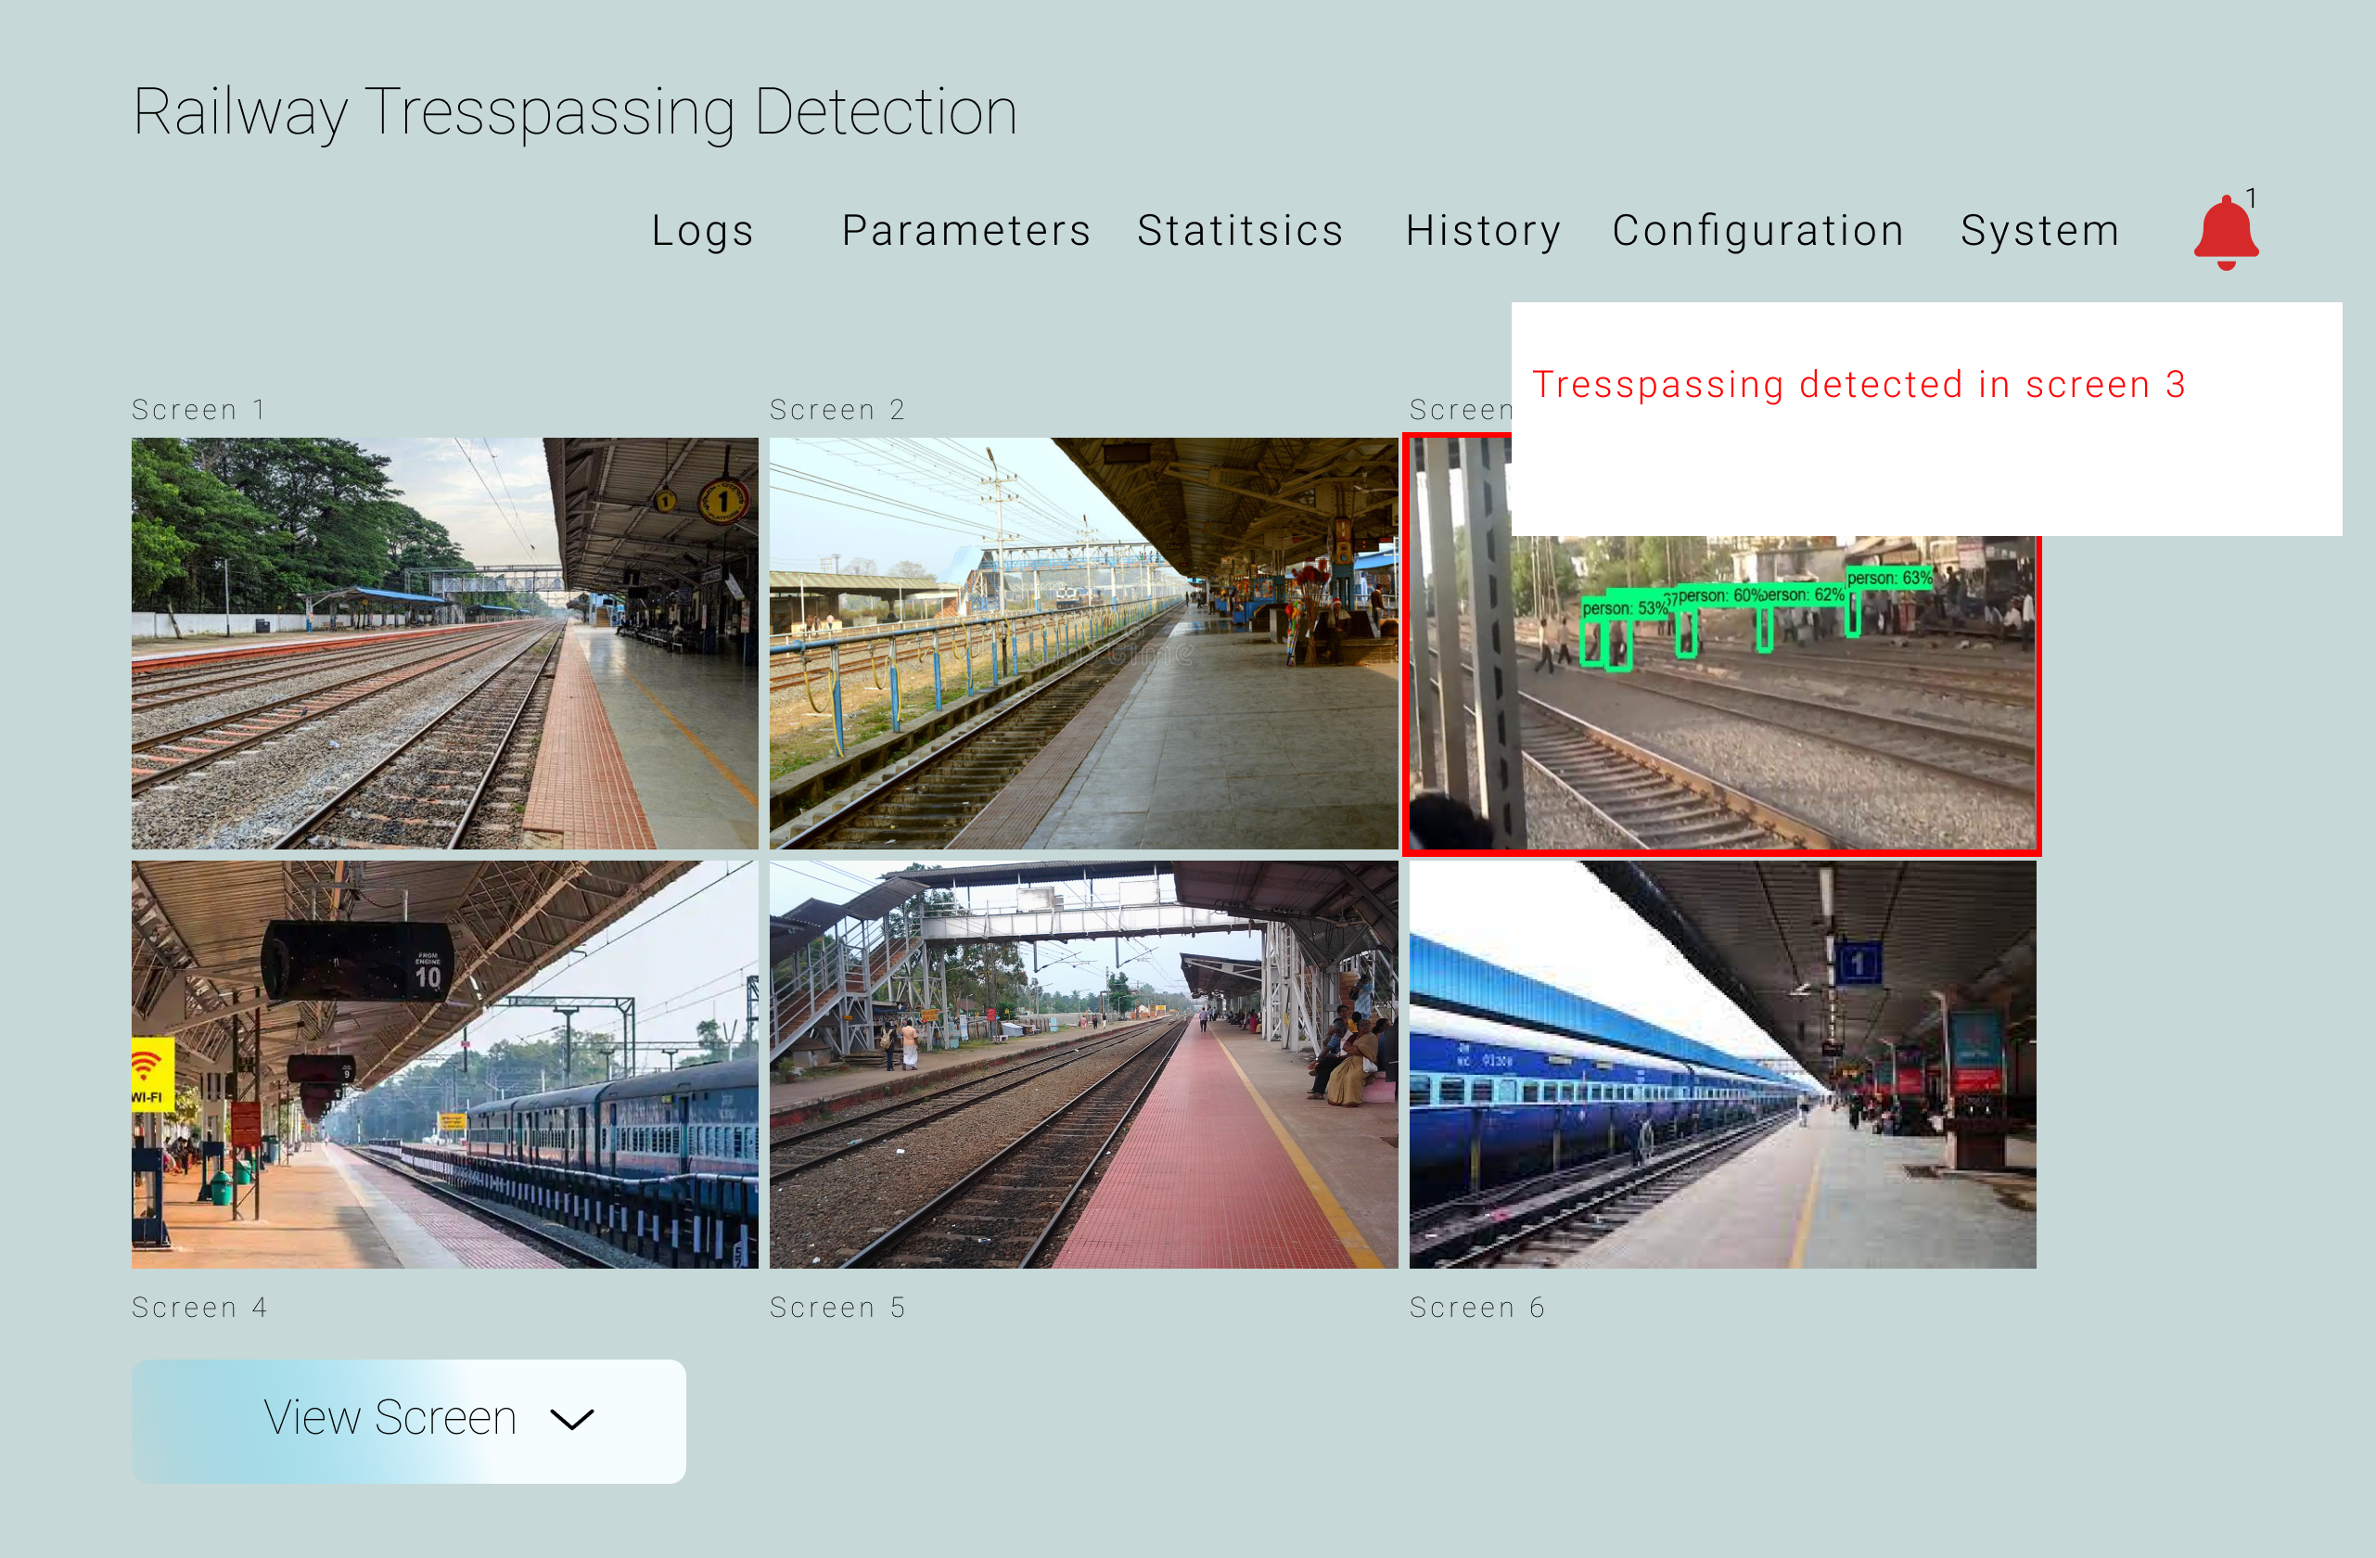
GUI Implementation Of project

Slide 26
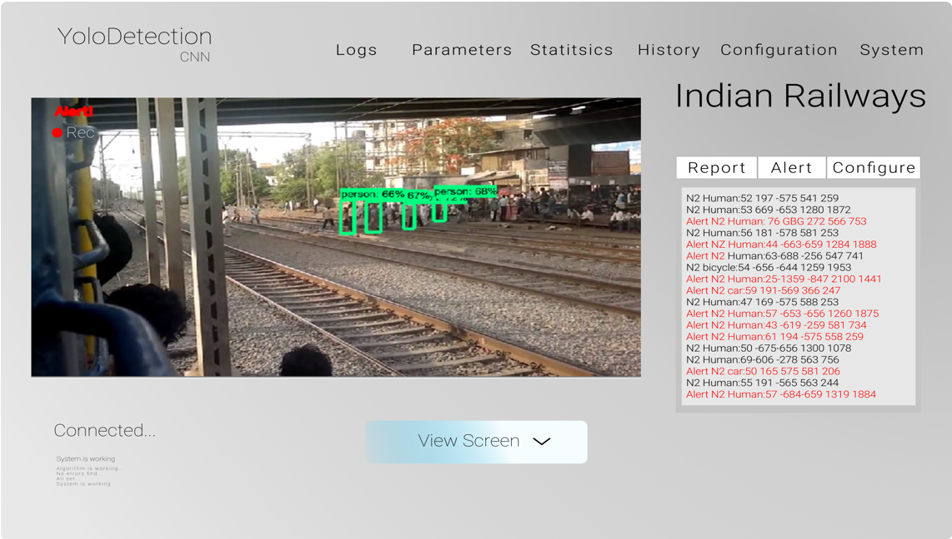
GUI Implementation Of project

Slide 27
Advantages
A real-time ability can be gained to help avoid risks
Many subsystems in the field can be integrated, including maintenance, security, traffic and passenger models, to form actions that consider multiple aspects.
Lessons and experience can be integrated into the learning process and automated effectively via machine learning, which is critical for safety systems.
The effectiveness of operations in stations and other areas linked to railway activities can be improved.
Time and costs can be saved while improving accuracy to enable long-term quality improvements.
Both passenger and workforce experiences can be improved, which reflect on the overall market image.
Data gathering can be enhanced to more fully utilise effective connections between assets and people.
With the help of this system the delay in railway can be avoided.
It helps in crowd management system.

Slide 28
disadvantages
There might be some issues that will occur in the future due to the large volume of data which affects the flow and speed of detecting desired outcomes.
Installation and maintenance is expensive.
Effectiveness of a Public Security Camera Is Doubted

Slide 29

Applications
1. Face Recognition A facial recognition system is a technology capable of matching a human face from a digital image or a video frame against a database of faces, typically employed to authenticate users through ID verification services, works by pinpointing and measuring facial features from a given image.
2. Person and Object detection Object detection is a computer technology related to computer vision and image processing that deals with detecting instances of semantic objects of a certain class (such as humans, buildings, or cars) in digital images and videos. Well-researched domains of object detection include face detection and pedestrian detection. Object detection has applications in many areas of computer vision, including image retrieval and video surveillance.
3. Security and Surveillance Surveillance is the monitoring of behaviour, many activities, or information for the purpose of information gathering, influencing, managing or directing. This can include observation from a distance by means of electronic equipment, such as closed-circuit television (CCTV), or interception of electronically transmitted information like Internet traffic.
And Many More…

Slide 30
4. Image Retrieval An image retrieval system is a computer system used for browsing, searching and retrieving images from a large database of digital images. Most traditional and common methods of image retrieval utilize some method of adding metadata such as captioning, keywords, title or descriptions to the images so that retrieval can be performed over the annotation words.
5. Advance driver-assistance systems Advanced driver-assistance systems (ADAS) are groups of electronic technologies that assist drivers in driving and parking functions. Through a safe human-machine interface, ADAS increase car and road safety. ADAS use automated technology, such as sensors and cameras, to detect nearby obstacles or driver errors, and respond accordingly.
6. Traveller Safety Authorities emphasize the importance of taking precautions to ensure travel safety. When traveling abroad, the odds favor a safe and incident-free trip, however, travellers can be subject to difficulties, crime and violence.

Slide 31
Project completion plan
Aug, Sep 2021
Oct 2021
Nov 2021
Dec 2021
Jan 2022
Feb 2022
Collection of related research papers
Read for the present models in the area and the scope of improvement
Prepare the roadmap of project and presentation for college.
Learn the new technologies for required for this project. And collect data
Complete the model building part of project and come up with best model.
Test model on unseen data. Fix Bugs. Develop front-end.

Slide 32
Conclusion
This system is capable of performing security check with deep learning models and with classification techniques to verify any breach in transitioning of object based detection and any trespassing detectection will generate signals to catch culprits with the help of forces and such techniques have some dependencies which are requires video capturing devices to generate results and can be verified with Convolutional neural network architecture which converts the data to vectors and perform analysis on top of it and predict desired outcomes. The detection is completely based on frames that is created by the algorithms to detect objects where each frame is independent to each other. With these data that we are going to gather day by day need to be stored in a way that requires fast computation and higher volume of data storage that will help us to do future predictions and avoid accidents.

Slide 33
FUTURE SCOPE
Future scope of video surveillance – The utility of VAaas:
For huge volumes of video archives, conventional analysis and storage methods have proven to be inefficient. It can never lead to prompt action and analysis. In many manifestations, data archives need to be stored for durations extending from a few months to years for compliance purposes. And this ends up in adding up to the life-cycle charges of video monitoring solutions. Therefore, just installing a surveillance camera system is not truly efficient. It needs to be complemented with the physical security staff.
Here is the point where cloud-based Video Analytics As-a-service (VAaaS) comes into the limelight. VAaaS can offer remarkable advantages over standalone video surveillance. The video analytic solutions are software based. They are typically deployed on the infrastructure like that of Amazon Web Services and Google Cloud Platform. These frameworks are proficient enough in discerning ambiguous patterns in the safety context. Technologies, for instance, Google Cloud Vision API, are trained to read texts, recognize human faces, and identify objects, emotions, and key landmarks.
When the software based video analytic solutions are combined with standalone surveillance systems, then these measures can host a whole new range of physical security use cases. Some of these are; advanced object tracking, loitering detection, perimeter defence, intrusion detection, human traffic flow, trip wire counting, crowd density management, people counting, face indexing and audience profiling. These solutions will not only minimize the need for physical security teams but will also empower security personnel with actionable intelligence.

Slide 34
VAaaS => Example Scenario:
Events where a large gathering is expected, for example, a football match, a famous shrine, or a crowded public place such as an airport; software-based surveillance solutions can be deployed to have enhanced public security and crowd management. Other purposes of this software are loitered detection, human traffic flow management, and people counting.
VAaaS => Integration:
Video analytics integrated with cloud infrastructure can serve for large-scale deployments. By large-scale, we mean hundreds of HD security cameras that would be delivering their video feeds simultaneously. Such setup can also be scaled up or down in accordance with the requirements. If the traffic is low, then the background IT infrastructure is scaled down or else, scaled up. This feature can deliver surprisingly good cost benefits.
When VAaaS methodologies are applied in a good manner, then the security professionals can use their time to solve the situations highlighted by video analytics rather than just analysing the security footage. One example can be handling accidents in traffic management, and another one could be solving a case of theft in retail stores.
VAaaS => Advantage:
The main drawback of traditional video surveillance is the high cost incurred in storing the video feeds. Modern video analytic solutions combined with cloud infrastructure target this problem with a different approach. Software-based video analytics use levelled cloud storage which gives high priority to ‘hot objects’ that comprises of important events and low priority to ‘cold objects’ such as archives and backups. Another disadvantage is a heavy initial investment, but this overcomes in ‘as-a-service’ option, where the client can get the benefits of ‘pay-as-you-go’ payment model.

Slide 35
REFERENCES
[1] Office of Rail and Road. "Annual statistical release - rail safety statistics." http://orr.gov.uk/__data/assets/pdf_file/0007/22876/railsafety-statistics-2015-16.pdf (accessed Mar. 5, 2019).
[2] Rail Safety and Standards Board (RSSB). "Annual safety performance report." http://www.hwa.uk.com/site/wpcontent/uploads/2017/09/CD6.8-RSSB-Annual-Reporton-Public-Safety-2015-2016.pdf (accessed Oct. 26, 2019).
[3] World Health Organization. "WHO global report on falls prevention in older age.",Community Health., https://www.who.int/violence_injury_prevention/publica tions/other_injury/falls_prevention.pdf?ua=1.(accessed Apr. 04, 2020).
[4] P. E. Waterson, V. L. Kendrick, R. A. Haslam, T. Jun, and B. Ryan, "Probing deeper into the risks of slips, trips and falls for an ageing rail passenger population: applying a systems approach," IET Intell. Transp. Syst., vol. 10, no. 1, pp. 25–31, Feb. 2016, doi: 10.1049/iet-its.2015.0047.
[5] R. Marks and J. P. Allegrante, "Falls-prevention programs for older ambulatory community dwellers: From public health research to health promotion policy," Sozial Präventivmedizin/Social Preventive Medicine, vol. 49, no. 3, pp. 171–178, Jun. 2004, doi: 10.1007/s00038- 004-3040-z.
[6] D. Helbing, I. Farkas, and T. Vicsek, "Simulating dynamical features of escape panic," Nature, vol. 407, no. 6803, pp. 487–490, Sep. 2000, doi: 10.1038/35035023.
[7] W. Fang, P. E. D. Love, H. Luo, and L. Ding, "Computer vision for behaviour-based safety in construction: A review and future directions," Adv. Eng. Inform., vol. 43, p. 100980, Jan. 2020, doi: 10.1016/j.aei.2019.100980
[8] S. Han and S. Lee, "A vision-based motion capture and recognition framework for behavior-based safety management," Automat. Construction, vol. 35, pp. 131– 141, Nov. 2013, doi: 10.1016/j.autcon.2013.05.001.
[9] S. Han, S. Lee, and F. Peña-Mora, "Vision-based detection of unsafe actions of a construction worker: Case study of ladder climbing," J. Comput. Civil Eng., vol. 27, no. 6, pp. 635–644, Nov. 2013, doi: 10.1061/(asce)cp.1943-5487.0000279.
[10] W.-R. Chang, S. Leclercq, T. E. Lockhart, and R. Haslam, "State of science: Occupational slips, trips and falls on the same level," Ergonomics, vol. 59, no. 7, pp. 861–883, 2016, doi: 10.1080/00140139.2016.1157214.

Slide 36

[11] R. Haslam and D. Stubbs, Understanding and Preventing Falls: An Ergonomics Approach: CRC Press,Boca Raton,Fla.;London:Taylor and Francis, pp. 209– 234.2005.
[12] R. Haslam and V. Filingeri, "Slips, trips and falls in crowds," in Proc. 20th Congr. Int. Ergonom. Assoc. (IEA 2018), Cham, Switzerland, Aug. 5, 2019, pp. 752–758.
[13] S. Y. Z. Au, G. Jenny, A. D. Livingston, and H. Roger, "Assessing spectator safety in seated areas at a football stadium," in Contemporary Ergonomics 2004, P. T. McCabe, Ed., Boca Raton, FL: CRC Press, 2014, pp. 23– 27.
[14] V. L. Kendrick, "The user experience of crowds," Ph.D. dissertation, Design School,Loughborough Univ., Loughborough, UK, 2013.
[15] I. Ahmad, Z. He, M. Liao, F. Pereira, and M. T. Sun, "Special issue on video surveillance," IEEE Trans. Circuits Syst. Video Technol., vol. 18, no. 8, pp. 1001– 1005, Aug. 2008, doi: 10.1109/tcsvt.2008.929646.
[16] J. Teizer and P. A. Vela, "Personnel tracking on construction sites using video cameras," Adv. Eng. Inform., vol. 23, no. 4, pp. 452–462, Oct. 2009, doi: 10.1016/j.aei.2009.06.011.
[17] J. Yang, O. Arif, P. A. Vela, J. Teizer, and Z. Shi, "Tracking multiple workers on construction sites using video cameras," Adv. Eng. Inform., vol. 24, no. 4, pp. 428–434, Nov. 2010, doi: 10.1016/j.aei.2010.06.008.
[18] Z. Zhu and I. Brilakis, "Concrete column recognition in images and videos," J. Comput. Civil Eng., vol. 24, no. 6, pp. 478–487, Nov. 2010, doi: 10.1061/(asce)cp.1943- 5487.0000053.
[19] I. P. T. Weerasinghe and J. Y. Ruwanpura, "Automated data acquisition system to assess construction worker performance," in Construction Res. Congr. 2009 Building Sustain. Future, Seattle, Washington, 2009, pp. 61–70.
[20] J. Gong, C. H. Caldas, and C. Gordon, "Learning and classifying actions of construction workers and equipment using Bag-of-Video-Feature-Words and Bayesian network models," Adv. Eng. Inform., vol. 25, no. 4, pp. 771–782, 2011/10 2011, doi: 10.1016/j.aei.2011.06.002.
[21] C. Chen, Z. Zhu, and A. Hammad, "Automated excavators activity recognition and productivity analysis from construction site surveillance videos," Automat. Construction, vol. 110, p. 103045, Feb. 2020, doi: 10.1016/j.autcon.2019.103045.
[22] S. Zheng, X. Chai, X. An, and L. Li, "Railway track gauge inspection method based on computer vision," in 2012 IEEE Int. Conf. Mechatronics Automat., Chengdu, China, Aug. 5–8, 2012, pp. 1292–1296.
[23] R. K. W. Vithanage, C. S. Harrison, and A. K. M. DeSilva, "Importance and applications of robotic and autonomous systems (RAS) in railway maintenance sector: A review," Computers, vol. 8, no. 3, p. 56, Jul. 2019, doi: 10.3390/computers8030056.
[24] A. Zaman, B. Ren, and X. Liu, "Artificial intelligenceaided automated detection of railroad trespassing," Transp. Res. Rec. J. Transp. Res. Board, vol. 2673, no. 7, pp. 25–37, May 2019, doi: 10.1177/0361198119846468.

Slide 37
[25] Y. Wu, Y. Qin, Z. Wang, X. Ma, and Z. Cao, "Densely pyramidal residual network for UAV-based railway images dehazing," Neurocomputing, vol. 371, pp. 124– 136, Jan. 2020, doi: 10.1016/j.neucom.2019.06.076.
[26] S. Ma, L. Gao, X. Liu, and J. Lin, "Deep learning for track quality evaluation of high-speed railway based on vehicle-body vibration prediction," IEEE Access, vol. 7, pp. 185099–185107, Mar. 2019, doi: 10.1109/access.2019.2960537.
[27] A. K. Singh, A. Swarup, A. Agarwal, and D. Singh, "Vision based rail track extraction and monitoring through drone imagery," ICT Express, vol. 5, no. 4, pp. 250–255, Dec. 2019, doi: 10.1016/j.icte.2017.11.010.
[28] M. Banić, A. Miltenović, M. Pavlović, and I. Ćirić, "Intelligent machine vision based railway infrastructure inspection and monitoring using UAV," Facta Universitatis Ser. Mech. Eng., vol. 17, no. 3, pp. 357–364, Nov. 2019, doi: 10.22190/fume190507041b.
[29] H. Alawad and S. Kaewunruen, "Wireless sensor networks: Toward smarter railway stations," Infrastructures, vol. 3, no. 3, p. 24, Jul. 2018, doi: 10.3390/infrastructures3030024.
[30] J. Liu, T. Li, P. Xie, S. Du, F. Teng, and X. Yang, "Urban big data fusion based on deep learning: An overview," Inf. Fusion, vol. 53, pp. 123–133, Jan. 2020, doi: 10.1016/j.inffus.2019.06.016.
[31] P. McMahon, T. Zhang, and R. Dwight, "Requirements for big data adoption for railway asset management," IEEE Access, vol. 8, pp. 15543–15564, Jan. 2020, doi: 10.1109/access.2020.2967436.
[32] P. Fraga-Lamas, T. M. Fernández-Caramés, and L. Castedo, "Towards the internet of smart trains: A review on industrial iot-connected railways," Sensors, vol. 17, no. 6, p. 1457, Jun. 2017, doi: 10.3390/s17061457.
[33] M. Takikawa, "Innovation in railway maintenance utilizing information and communication technology (smart maintenance initiative)," Japan Railway & Transit Review, no. 67, pp. 22–35, Mar. 2016. [Online].Available: http://www.ejrcf.or.jp/jrtr/jrtr67/pdf/22-35.pdf
[34] D. Xie, L. Zhang, and L. Bai, "Deep learning in visual computing and signal processing," Appl. Comput. Intell. Soft Comput., vol. 2017, p. 1320780, Feb. 2017, doi: 10.1155/2017/1320780.
[35] D. Yu and L. Deng, "Deep learning and its applications to signal and information processing [exploratory DSP]," IEEE Signal Process. Mag., vol. 28, no. 1, pp. 145–154, Jan. 2011, doi: 10.1109/msp.2010.939038.
[36] O. Abdel-Hamid, A. Mohamed, H. Jiang, and G. Penn, "Applying Convolutional Neural Networks concepts to hybrid NN-HMM model for speech recognition," in 2012 IEEE Int. Conf. Acoust. Speech Signal Process. (ICASSP), Kyoto, Japan, Mar. 25–30, 2012, pp. 4277– 4280.
[37] H. C. Shin et al., "Deep convolutional neural networks for computer-aided detection: CNN architectures, dataset characteristics and transfer learning," IEEE Trans. Med. Imaging, vol. 35, no. 5, pp. 1285–1298, 2016, doi: 10.1109/TMI.2016.2528162.

